Slide 1
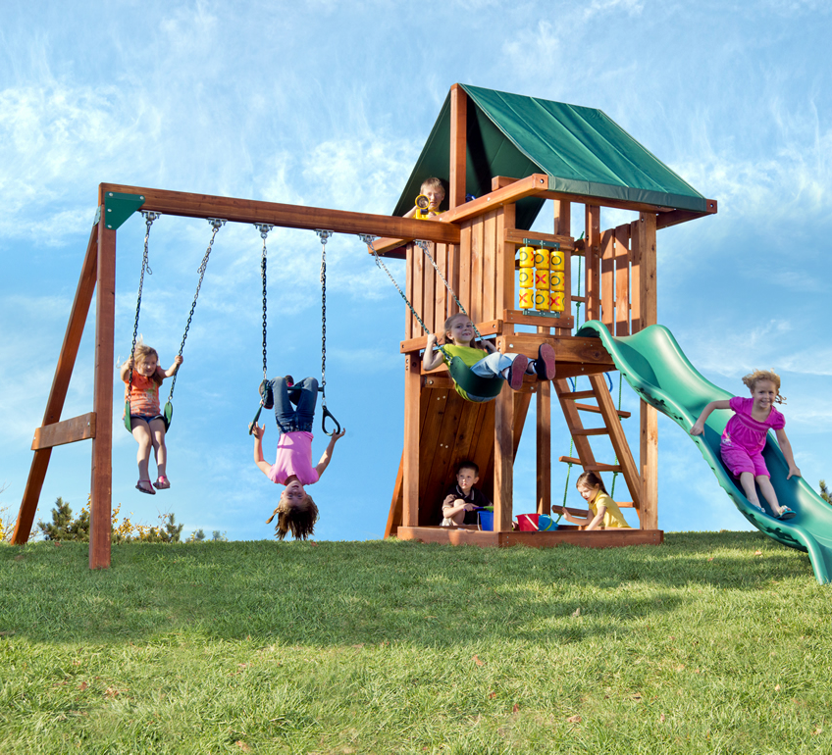

Recognizing and addressing Sensory Processing Disorder in Children
Kiki Matemba-Belli
BSc.( Hons)OT
Dip. PMLD& MSI (Paediatrics)

Slide 2

Agenda
Introductions
Our Senses, Why we Have Them and How
They Function/Work
What Happens When a child has Sensory
Processing Difficulties.
Developmental function discussion
Vestibular and Proprioception Difficulties
Questions and discussion
Why sleep is important
How we can help/support children to sleep
Notes:
9.00-9.15 find out name and information about one other person to introduce them
9.15 -9.30 Introductions and discussion around practice in schools

Slide 3

8 Sensory Systems
Vision
Hearing
Touch
Taste
Smell
Vestibular
Proprioception
Interoception

Slide 4
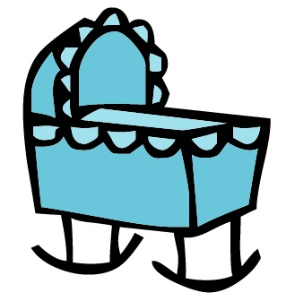
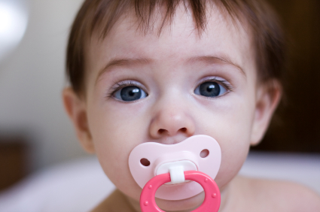
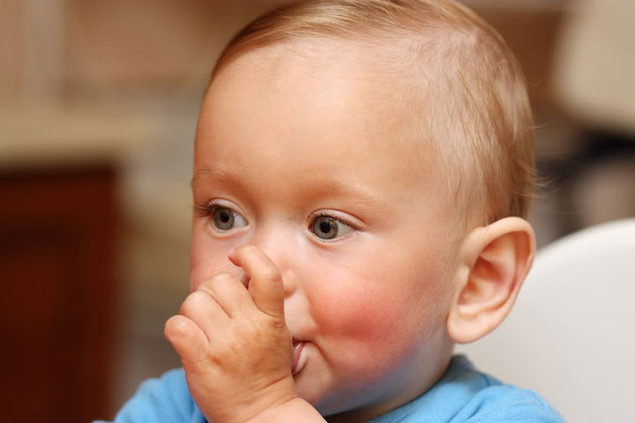
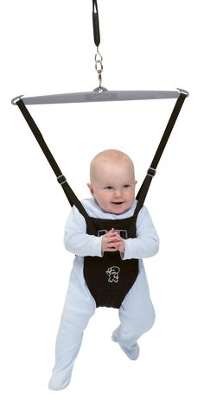

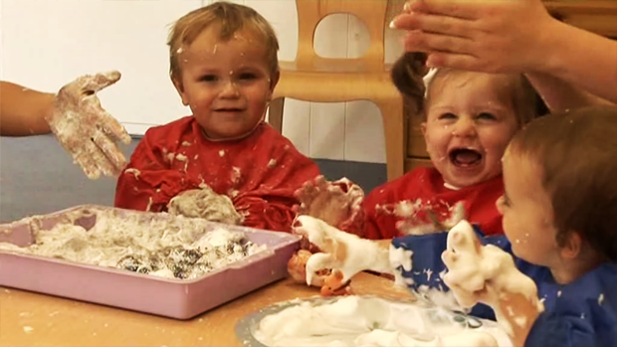
Sensory integration and child development
Notes:
Typical developmental pattern seen in child development
4

Slide 5
Vestibular processing difficulty
Sensory Seeker/under-responsive
craving/seeking out activities requiring feet to leave the ground such as swings, slides, riding a bike, jumping or climbing.
Appearing to never become dizzy with excessive spinning
Seemingly unaware of danger/risks or impulsively jumping, running, and/or climbing
Avoids Sensory experiences/over-responsive
Dislikes/fears activities requiring feet to leave the ground such as swings, slides, riding a bike, jumping or climbing.
Often moving slowly/cautiously
Frequent motion sickness/dizziness
Appearing frequently “lost” in their environment or having difficulty locating objects
Clumsiness or frequent falling

Slide 6
Sensory Seeker/under-responsive
Rocking, spinning, twirling, or frequent head tilting
Difficulty sitting still or unable to sustain attention without moving
Avoids Sensory experiences/over-responsive
May also intently watch moving objects
Often prefers sedentary activities
Often slouches, holds head up with hands, or prefers lying down
Difficulty with reading, writing, and/or math

Slide 7
Strategies
Sensory Seeker/under-responsive
Offer movement opportunities to enable optimum threshold so that they can make sense of their environment.
Allow movement when expected to engage in tasks, interacting or listen
Outdoor activities i.e. biking, wall climbing, roller skating any sports
Sensory Avoider overresponsive
Offer opportunities for movement but not to the same extend as the sensory seeker, needs to be gentle and less intense.
Gradually build up the movement intensity.
Notes:
Equipment which can be used at home required in the home: trampoline, swings, gym/peanut balls, balancing board/aircushion, Scooter/scooter board

Slide 8
Proprioception processing difficulty
Sensory Seeker/under-responsive
Easily frustrated
Frequent crashing, bumping, climbing, falling, or jumping
Frequent kicking while sitting or stomping feet while walking
Enjoys deep pressure from bear hugs, being “squished,” being wrapped in tight blankets, or lying under something heavy
Avoids Sensory experiences/over-responsive
Misjudges the amount of force needed to pick up objects (may often spill, break or drop things, or complain that objects are too heavy to carry)
Doesn’t like being hugged or squished difficulty isolating body movements or locating body parts when eyes are closed
Easily startled by the slightest or unexpected pressure.

Slide 9
Sensory Seeker/under-responsive
Uses too much force for writing/colouring, may break the tip of the pencil or rip the paper while erasing, or complain about hand fatigue
Often plays too rough with peers, siblings, or pets
Wants to wear clothes and accessories too tight
Avoids Sensory experiences/over-responsive
Uses less pressure when holding pencil not motivated to engage in handwriting
Doesn’t like rough and tumble activities
Doesn’t like tight spaces/clothing

Slide 10
Strategies
Sensory Seeker/under-responsive
Activities which provide deep pressure, climbing activities, running, jumping wall/floor press ups
Push, pulling and stretching activities using elastic bands, ropes, gardening activities, carrying heavy shopping bags/ backpack
Depending on age tight hugs and cuddles
Figure hugging/tight clothes
Chewy toys/snacks
Sensory Avoider over-responsive
Drinking using twisted straws or Chewy toys/snacks can be calming and allow a child to tolerate proprioceptive activities.
Notes:
Equipment which may be helpful: weighted vests/blanket/lap pads, gym/peanut balls balancing board/air cushions or beanbags, body socks

Slide 11
Interventions should…
Provide rest / relief from pain and discomfort
Provide a positive experience
Adapt behaviours
Improve function / occupation
Overcome difficulties
Enable learning

Slide 12
References:
https://www.youtube.com/watch?v=b2iOliN3fAE
2. The Sensory Team handbook by Nancy Mucklow [A hands 0n tool to help young people make sense of their senses and take charge of their sensory processing]
3. Starting Sensory Therapy: Fun Activities for Home and Classroom
4. Understanding Your Senses by Winnie Dunn

